Slide 1
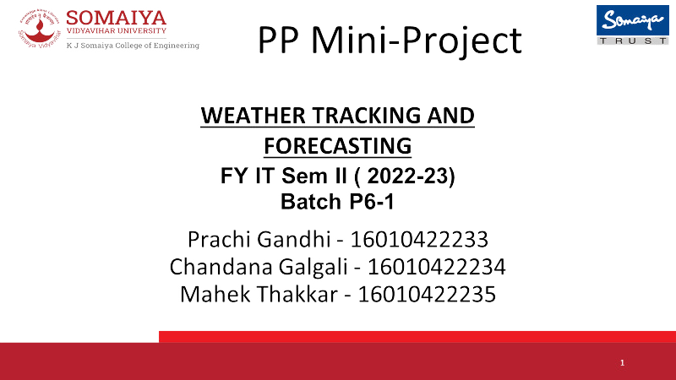




WEATHER TRACKING
AND FORECASTING
FY IT Sem II ( 2022-23)
Batch P6-1
Prachi Gandhi - 16010422233
Chandana Galgali - 16010422234
Mahek Thakkar - 16010422235

Slide 2


Problem Statement
The goal of this mini project is to develop a weather forecasting system that predicts the probabilities of various weather events based on the current weather conditions of a specified city.

Slide 3


System
Architecture
01
02
03
04
Step one
Step two
Step three
Step four
Retrieve current weather data of the city inputted by the user using WeatherStack API.
Process the weather data to extract relevant information (temperature, humidity, weather code).
Calculate the probabilities of rain, sleet, snow, thunderstorms, cyclones, blizzards, hailstorms and fog based on the extracted information.
Display the calculated probabilities to the user.

Slide 4
Implementation Details
"WEATHER TRACKING AND FORECASTING PROGRAM"
#Importing the necessary libraries
import requests #A library for making HTTP requests
import json #A library for working with JSON data
import math #A library for mathematical operations
#To retrieve current weather data for a specified city
def get_current_weather(api_key, city): #The function takes 2 arguments: the API key and the city
#Setting a variable to the URL of the Weatherstack API's current weather endpoint
base_url = "http://api.weatherstack.com/current"
#Creating a dictionary that contains the API key and the city name as query parameters
params = {
"access_key": api_key,
"query": city,
}
#Making an HTTP GET request to the Weatherstack API's current weather endpoint then passing the URL and the query parameters as arguments
response = requests.get(base_url, params=params)
#Returning the JSON data from the API response
return response.json()
api_key = "f9374dfb90b487d7f7e273755528716e"
#Prompting the user to enter the name of the city for which they want to retrieve the weather data
city = input("Find the weather forecast of (enter city name): ")
#Calling the function and passing in the API key and the city name as arguments
current_weather = get_current_weather(api_key, city)
print(json.dumps(current_weather, indent=1))

Slide 5
Implementation Details
#To scale the probability percentage in the range 0-100
def sigmoid(x):
return 1 / (1 + math.exp(-x))
#To calculate the probabilities of various weather events such as rain, sleet, snow, thunderstorms, cyclones, blizzards, hail, and fog
def forecast_probabilities(current_weather): #The function takes the JSON object as an argument
#Extracting the temperature, humidity, and weather code from the JSON object
temperature = current_weather["current"]["temperature"]
humidity = current_weather["current"]["humidity"]
weather_code = current_weather["current"]["weather_code"]
#Initializing the probabilities of various weather events to 0
rain_probability = 0
sleet_probability = 0
snow_probability = 0
thunderstorm_probability = 0
cyclone_probability = 0
blizzard_probability = 0
hail_probability = 0
fog_probability = 0

Slide 6
Implementation Details
if weather_code in [113]: #Clear/Sunny
rain_probability = humidity * 0
elif weather_code in [116, 119, 122, 143]: #Partly Cloudy/Cloudy/Overcast/Mist
rain_probability = humidity * 0.1
elif weather_code in [176, 263, 266, 293, 296, 353, 386]: #Light Rainfall
rain_probability = humidity * 0.25
elif weather_code in [299, 302, 356, 389]: #Moderate Rainfall
rain_probability = humidity * 0.50
elif weather_code in [305, 308, 359]: #Heavy Rainfall
rain_probability = humidity * 0.75
rain_probability = sigmoid(rain_probability)
if weather_code in [182, 185, 281, 311, 317, 362, 374]: #Light Sleet showers
sleet_probability = humidity * 0.25
elif weather_code in [284, 314, 320, 350, 365, 377]: #Moderate to Heavy Sleet Showers
sleet_probability = humidity * 0.75
sleet_probability = sigmoid(sleet_probability)
if weather_code in [179, 227, 323, 326, 392]: #Light Snowfall
snow_probability = humidity * 0.25
elif weather_code in [329, 332, 368]: #Moderate Snowfall
snow_probability = humidity * 0.50
elif weather_code in [335, 338, 371, 395]: #Heavy Snowfall
snow_probability = humidity * 0.75
snow_probability = sigmoid(snow_probability)

Slide 7
Implementation Details
if weather_code in [200, 386, 389, 392, 395]:
thunderstorm_probability = 0.5
if weather_code in [362, 365, 368, 371, 374, 377]:
cyclone_probability = 0.5
if weather_code in [230]:
blizzard_probability = 1
if temperature <= 0 and humidity >= 80:
hail_probability = 0.5
if weather_code in [248, 260]:
fog_probability = 1
#Returning the calculated probabilities
return rain_probability, sleet_probability, snow_probability, thunderstorm_probability, cyclone_probability, blizzard_probability, hail_probability, fog_probability
#Calling the forecast_probabilities function and printing the probabilities of the weather events:
rain_prob, sleet_prob, snow_prob, thunderstorm_prob, cyclone_prob, blizzard_prob, hail_prob, fog_prob = forecast_probabilities(current_weather)
print(f"Rainfall probability: {rain_prob * 100:.2f}%")
print(f"Sleet-shower probability: {sleet_prob * 100:.2f}%")
print(f"Snow probability: {snow_prob * 100:.2f}%")
print(f"Thunderstorm probability: {thunderstorm_prob * 100:.2f}%")
print(f"Cyclone probability: {cyclone_prob * 100:.2f}%")
print(f"Blizzard probability: {blizzard_prob * 100:.2f}%")
print(f"Hail probability: {hail_prob * 100:.2f}%")
print(f"Fog probability: {fog_prob * 100:.2f}%")

Slide 8
Features of Designed System
Fetches real-time weather data using WeatherStack API.
Calculates the probabilities of different weather events (for e.g. rainfall, sleet-showers, snowfall, thunderstorms, cyclones, blizzards, hailstorms, fog, etc.)
Supports forecasting for any city supported by the WeatherStack API.
Easy to integrate with other applications or services.

Slide 9
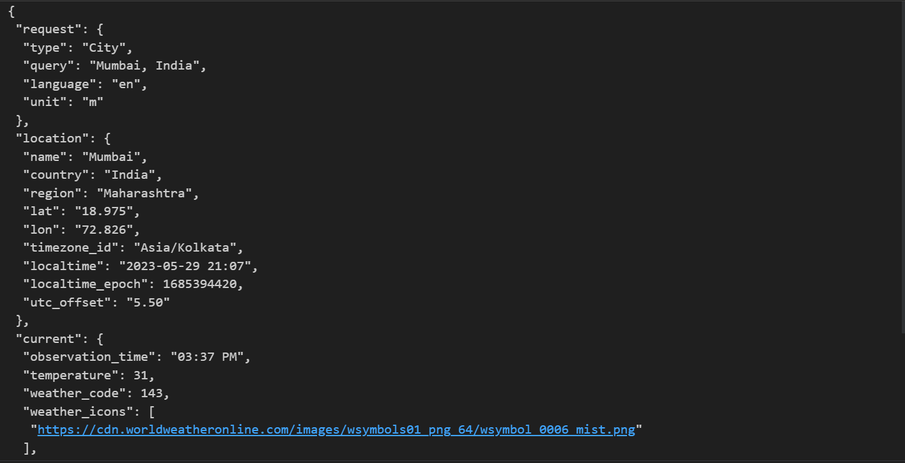
Output Snapshots
For Mumbai:

Slide 10
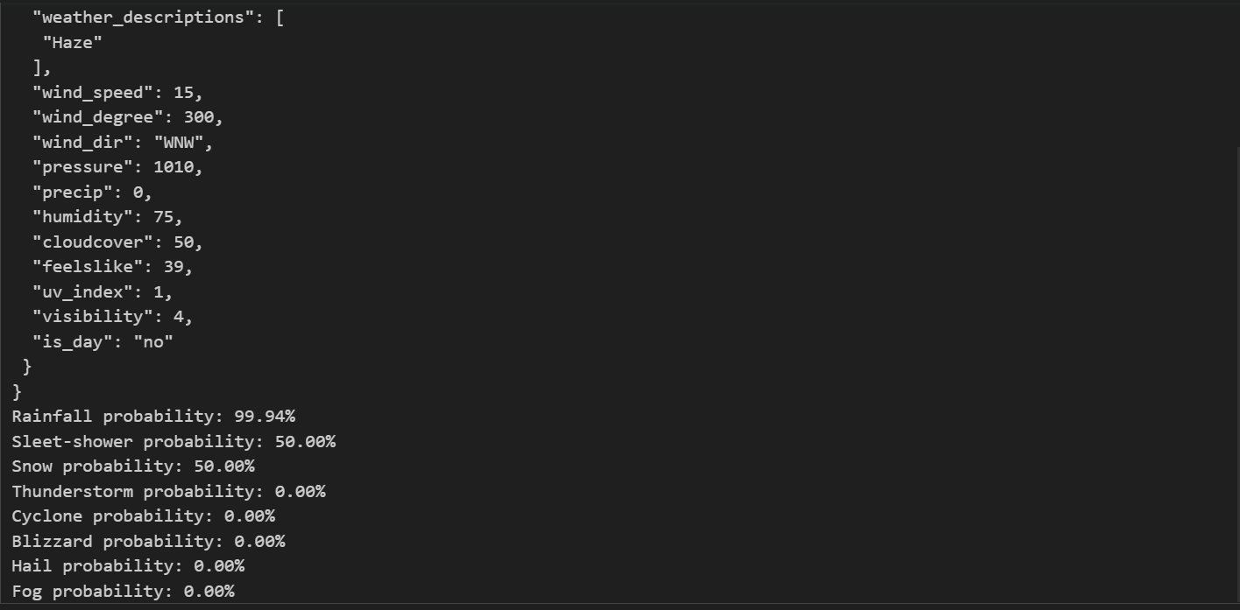
Output Snapshots

Slide 11
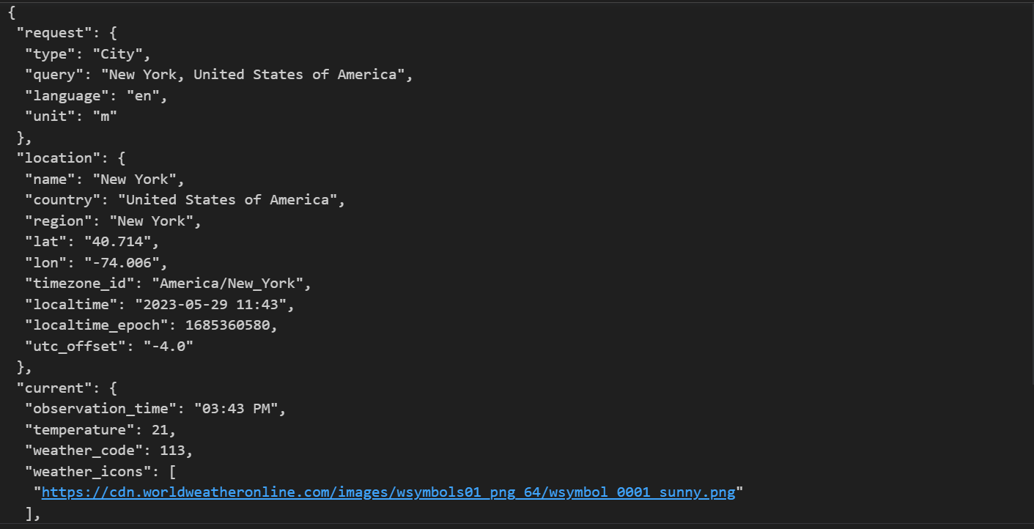
Output Snapshots
For New York:

Slide 12
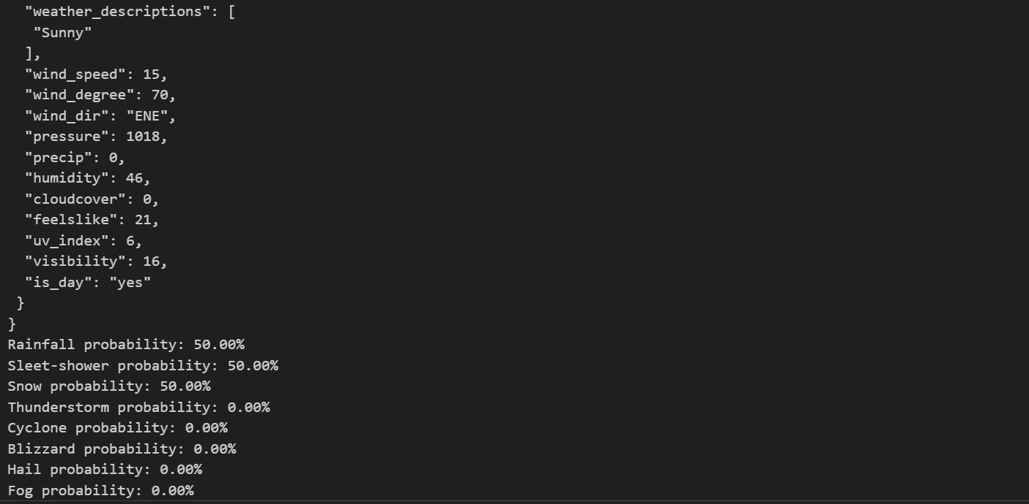
Output Snapshots

Slide 13
Results
The system first displays the current weather conditions of the city inputted by the user. It then successfully calculates and displays the probabilities of rainfall, sleet-showers, snowfall, thunderstorms, cyclones, blizzards, hailstorms and fog for the specified city based on the current weather conditions such as temperature, humidity and the weather code.

Slide 14
Conclusion
The developed weather forecasting system provides a simple and effective way to predict the likelihood of various weather events. It can be further improved by incorporating more advanced algorithms and additional data sources to increase the accuracy of the predictions.

Slide 15
References
WeatherStack API Documentation: https://weatherstack.com/documentation
Sigmoid Function: https://en.wikipedia.org/wiki/Sigmoid_function
Weather Codes: https://weatherstack.com/documentation#weather_codes

Slide 16

THANK YOU

